Slide 1
Diabetes Risk Factors
Team Immortals
ALY6140: Analytics System Technology
Sai Ashwin Anumula, Vamshi Krishna Korutla, Vyas Kadiyala, Xiaoxi Li
May 15, 2025

Slide 2

Background
Current scenario:
Diabetes remains one of the most pressing health challenges worldwide, affecting
millions of people and burdening healthcare systems. With rising global rates of both
diabetes and prediabetes, understanding the factors that increase the risk of developing
this condition is more important than ever.

Slide 3







Introduction
Diabetes represents a critical global health challenge affecting millions worldwide. Our project analyzes the "Diabetes Health Indicators Dataset" from Kaggle, containing over 250,000 records with diverse health metrics and demographics including BMI, age, income, physical activity, and smoking habits. We employ three analytical approaches: Random Forest Classification, K-Means Clustering, Logistic Regression, XG boost, Neural network from deep learning . This multi-method approach balances predictive power with interpretable insights to enhance our understanding of diabetes risk factors.

Slide 4




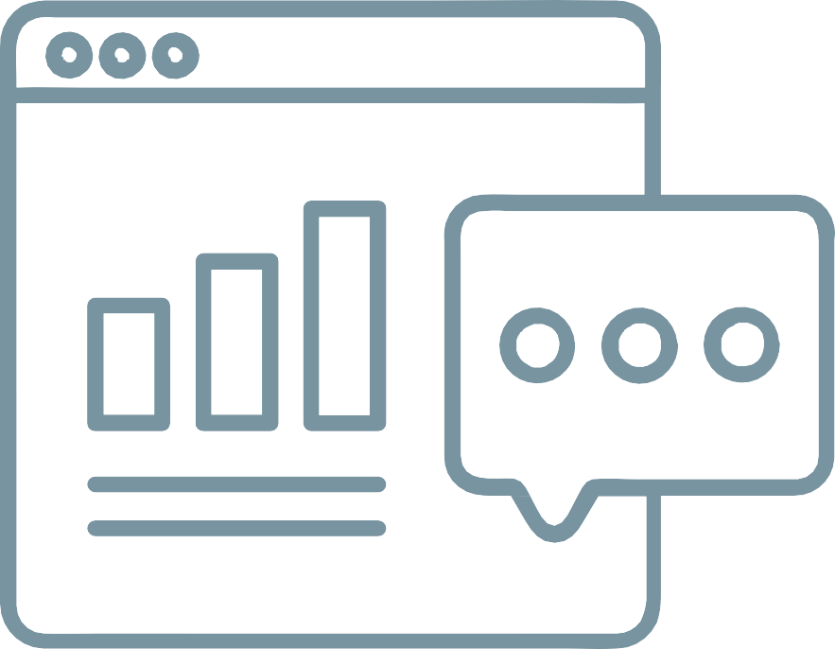


Key Questions
What lifestyle and demographic factors are most strongly associated with diabetes and prediabetes?
How do income levels and healthcare access affect the likelihood of developing diabetes and the ability to manage it?
Can we develop a model that accurately predicts an individual’s risk of having or developing diabetes?

Slide 5
About the dataset
Health Status Variables
Diabetes_012: 0 = No diabetes, 1 = Prediabetes, 2 = Diabetes
HighBP: 0 = No high blood pressure, 1 = Has high blood pressure
HighChol: 0 = No high cholesterol, 1 = Has high cholesterol
CholCheck: 0 = No cholesterol check in past 5 years, 1 = Had check in past 5 years
Stroke: 0 = No history of stroke, 1 = Has had a stroke
HeartDiseaseorAttack: 0 = No history, 1 = Has had heart disease/attack
GenHlth: 1 = Excellent, 2 = Very good, 3 = Good, 4 = Fair, 5 = Poor
MentHlth & PhysHlth: Days (0-30) with poor health in past 30 days
DiffWalk: 0 = No difficulty walking/climbing stairs, 1 = Has difficulty
Lifestyle Variables
Smoker: 0 = Non-smoker, 1 = Smoker
PhysActivity: 0 = No activity in past 30 days, 1 = Had activity
Fruits: 0 = Does not consume daily, 1 = Consumes daily
Veggies: 0 = Does not consume daily, 1 = Consumes daily
HvyAlcoholConsump: 0 = No heavy consumption, 1 = Heavy consumption

Slide 6

Healthcare Access
AnyHealthcare: 0 = No healthcare coverage, 1 = Has coverage
NoDocbcCost: 0 = No missed doctor visits due to cost, 1 = Missed visits due to cost
Demographic Variables
Sex: 0 = Female, 1 = Male
Age:
1 = 18-24, 2 = 25-29, 3 = 30-34, 4 = 35-39, 5 = 40-44
6 = 45-49, 7 = 50-54, 8 = 55-59, 9 = 60-64
10 = 65-69, 11 = 70-74, 12 = 75-79, 13 = 80+
Education:
1 = Never attended/kindergarten only, 2 = Elementary (Grades 1-8)
3 = Some high school (Grades 9-11), 4 = High school graduate/GED
5 = Some college (1-3 years), 6 = College graduate (4+ years)
Income:
1 = <$10,000, 2 = $10,000-<$15,000, 3 = $15,000-<$20,000
4 = $20,000-<$25,000, 5 = $25,000-<$35,000
6 = $35,000-<$50,000, 7 = $50,000-<$75,000, 8 = $75,000+
Shape of the dataset:

Slide 7
Exploratory Data Analysis
Data Cleaning Process
Our data preparation involved several methodical steps to ensure quality and reliability:
Imported the dataset into Jupyter Notebook for analysis
Performed initial summary statistics to understand the key values and distribution in each column
Verified that all data was already properly encoded, eliminating the need for string-to-integer conversion
Conducted null value checks, confirming the dataset was complete with no missing values
Identified outliers through box plot visualization and mitigated them using the Interquartile Range (IQR) formula
Completed the preparation phase with comprehensive visual analysis of the dataset to identify patterns and relationships

Slide 8
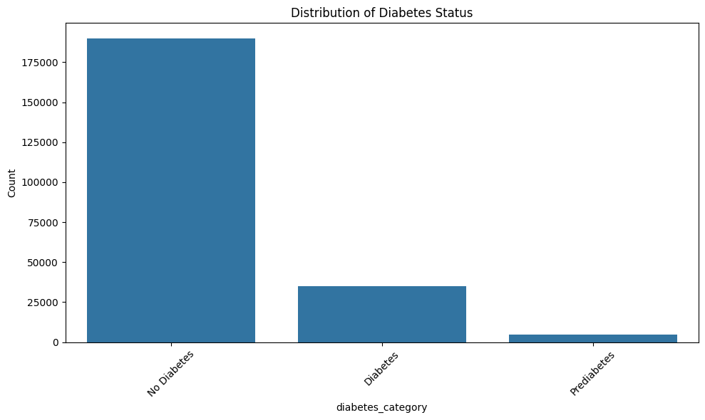
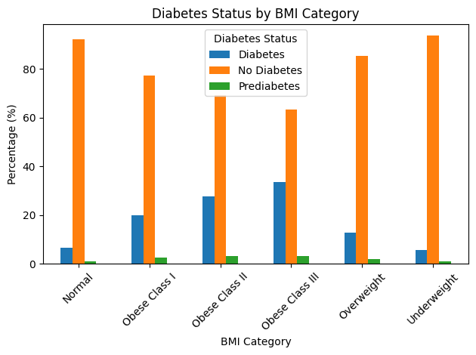
Visualizations
The image shows a bar chart titled "Distribution of Diabetes Status" with three categories: "No Diabetes" (~175,000 count), "Diabetes" (~35,000 count), and "Prediabetes" (~5,000 count), indicating that the majority of the studied population does not have diabetes.
This bar chart shows the percentage distribution of diabetes status (Diabetes, No Diabetes, Prediabetes) across different BMI categories, with obesity class III having the highest diabetes prevalence.

Slide 9
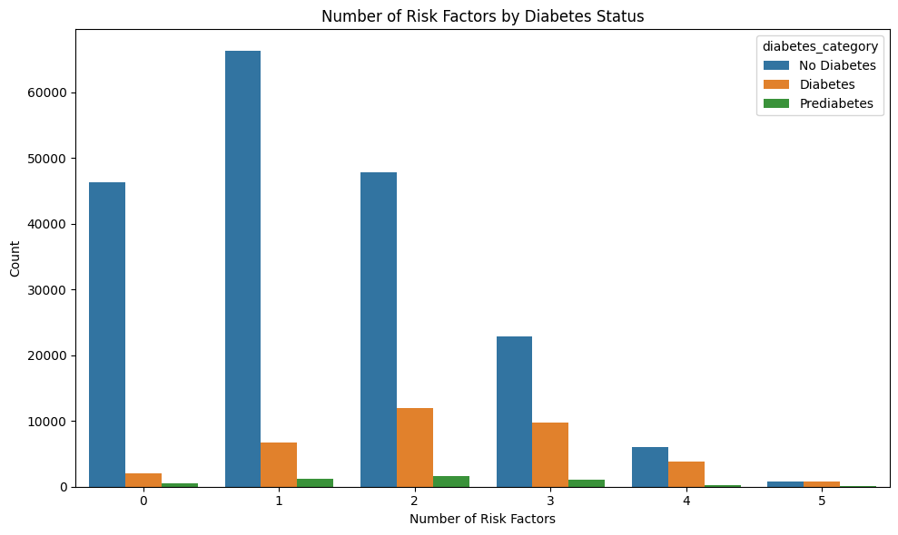
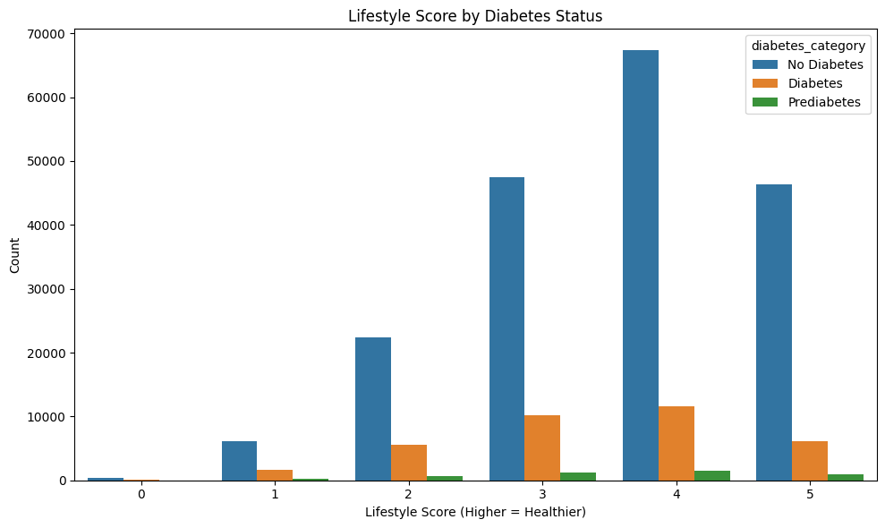
This bar chart displays the count of individuals by their number of risk factors (0-5) across three diabetes categories, showing that people with diabetes tend to have more risk factors than those without diabetes, while the highest count overall is for individuals with 1 risk factor in the "No Diabetes" category.
The chart displays the distribution of lifestyle scores (0-5, with higher scores indicating healthier lifestyles) by diabetes status. Individuals without diabetes (blue bars) overwhelmingly have healthier lifestyle scores (3-5), while those with diabetes (orange bars) show lower overall counts but peak at moderate lifestyle scores (3-4).

Slide 10
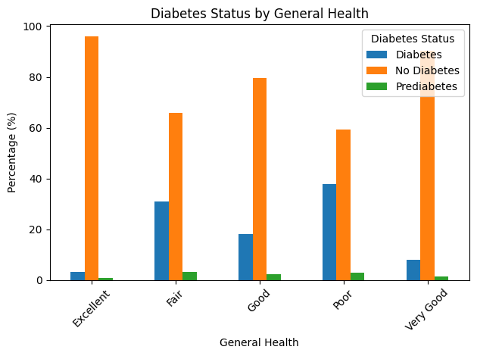
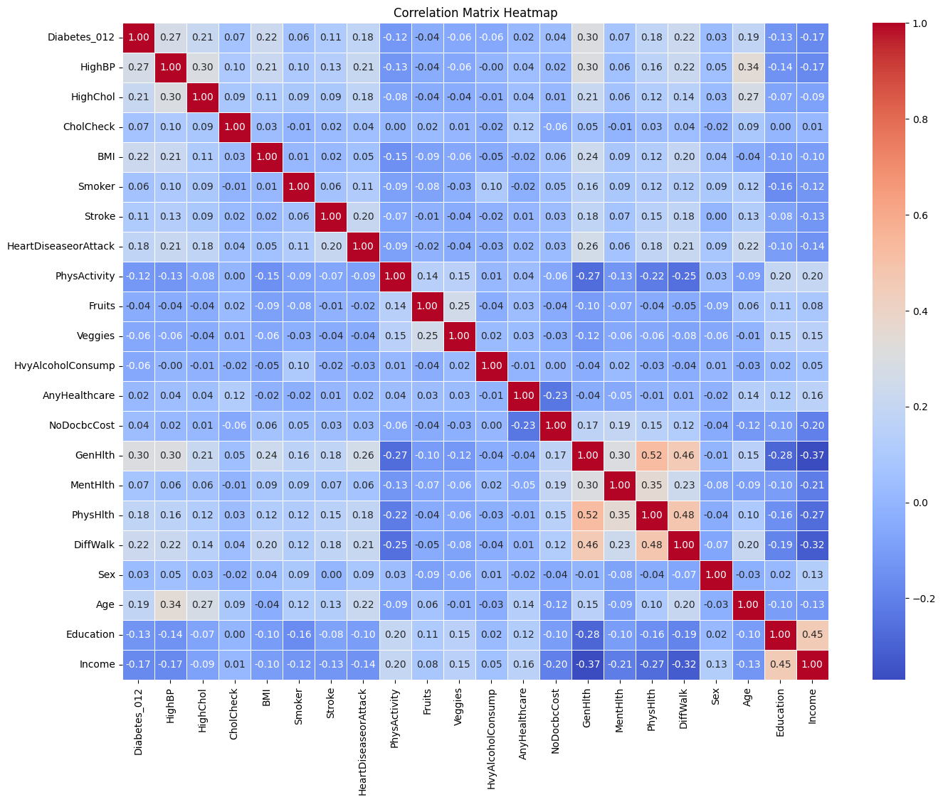
This chart shows diabetes status percentages across general health categories. People without diabetes dominate in "Excellent" and "Very Good" health (95-97%), while diabetes prevalence is highest in "Poor" health (38%) and "Fair" health (30%). Prediabetes remains minimal across all categories. The pattern clearly indicates that poorer self-reported health correlates with higher diabetes rates.
This correlation heatmap shows relationships between health variables with diabetes at the top left. Red squares indicate positive correlations (especially along the diagonal at 1.0), while blue represents negative correlations. HighBP appears moderately correlated with diabetes (around 0.3), while most other variables show weaker relationships. The matrix effectively visualizes how multiple health factors interconnect, with most correlations falling between -0.4 and 0.4.

Slide 11
Classification models in machine learning and deep learning
Since the dataset is skewed toward nondiabetic cases (labeled 0) compared to prediabetic (labeled 1) and diabetic (labeled 2), we will apply a sampling technique to select training and testing data from the main dataset.
Method | Models | Description
SMOTE (Synthetic Minority Over-sampling Technique) | Logistic Regression Random Forest XGBoost ,SVM Neural Network | SMOTE generates synthetic samples for the minority classes by interpolating between existing minority class examples. It creates new instances along the line segments joining any/all the k minority class nearest neighbors.
Under sampling | Logistic Regression Random Forest XGBoost | Undersampling reduces the number of observations from the majority class to balance the distribution. It randomly removes samples from the majority class until the desired balance is achieved.
Class Weighting | Logistic Regression Random Forest XGBoost Neural Network | Class weighting assigns higher weights to the minority class during model training. This penalizes misclassification of the minority classes more heavily, forcing the classifier to pay more attention to these classes without changing the data distribution.

Slide 12
Model information
Logistic Regression: Predicts probability of binary outcomes using the logistic function. Models relationships between features and outcomes with interpretable coefficients. Simple, effective for linear data; less suited for complex, non-linear patterns. Widely used in medicine, finance, and more for classification tasks.
Random Forest: Ensemble method using multiple decision trees for classification/regression. It reduces overfitting by averaging predictions, offering robustness and high accuracy. Handles non-linear data well but can be computationally intensive. Popular in finance, healthcare for its versatility and feature importance insights.
XGBoost: Gradient boosting framework optimizing decision trees for speed and performance. It excels in structured data tasks with high accuracy via iterative error correction. Scalable, handles missing data, but requires tuning to avoid overfitting. Widely used in Kaggle competitions and industry applications.
SVM (Support Vector Machine): Classifies data by finding the optimal hyperplane maximizing margin between classes. Effective for high-dimensional, non-linear data using kernel tricks. Computationally intensive for large datasets, sensitive to parameter tuning. Common in text classification, image recognition.
Neural Network: Models complex patterns via interconnected nodes in layers, inspired by the human brain. Excels in non-linear, high-dimensional tasks like image/speech recognition. Requires large data, computational power, and tuning; less interpretable. Dominant in deep learning applications.

Slide 13
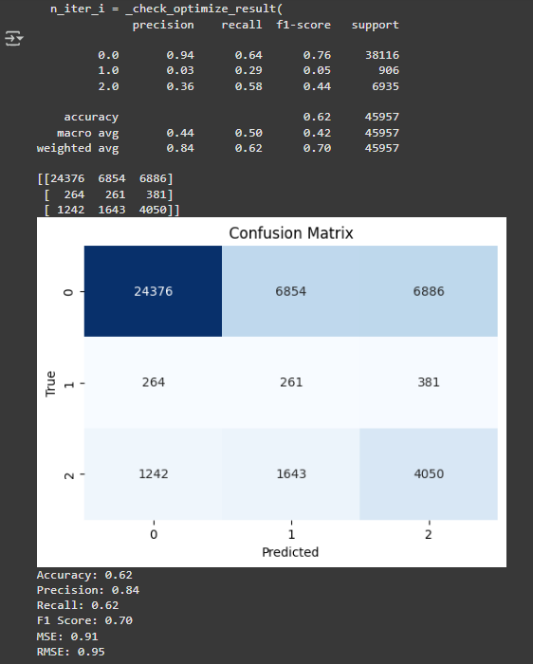
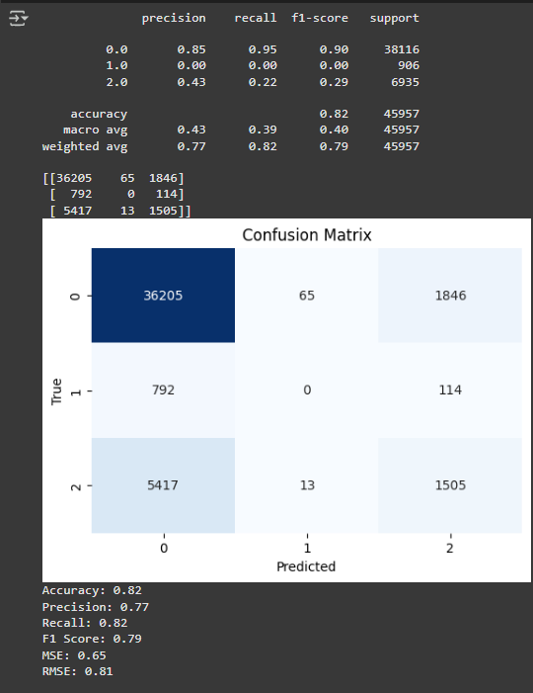
Outputs
Using Smote Sampling for Logistic Regression
Using Smote sampling for RandomForest

Slide 14
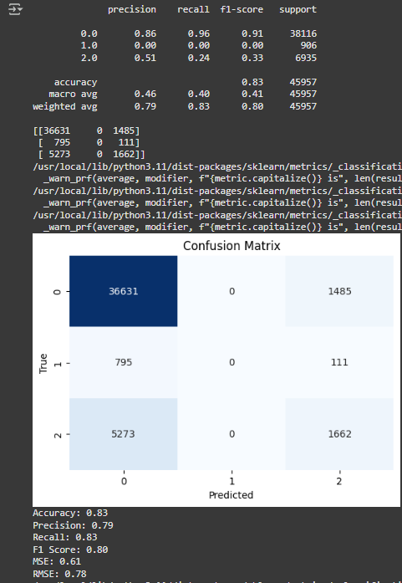
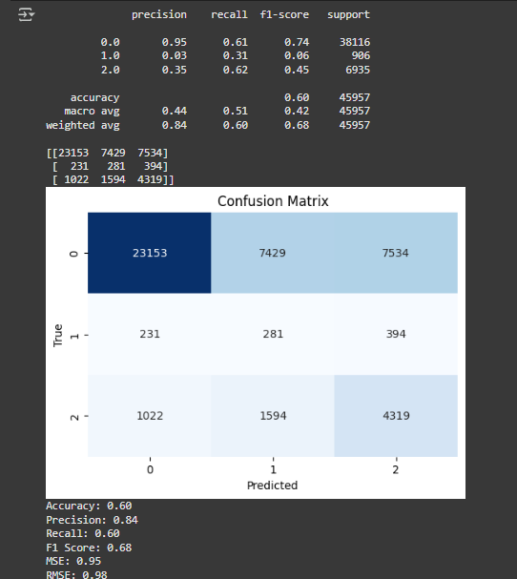
Using Smote Sampling for XG boost
Using smote sampling for SVM

Slide 15
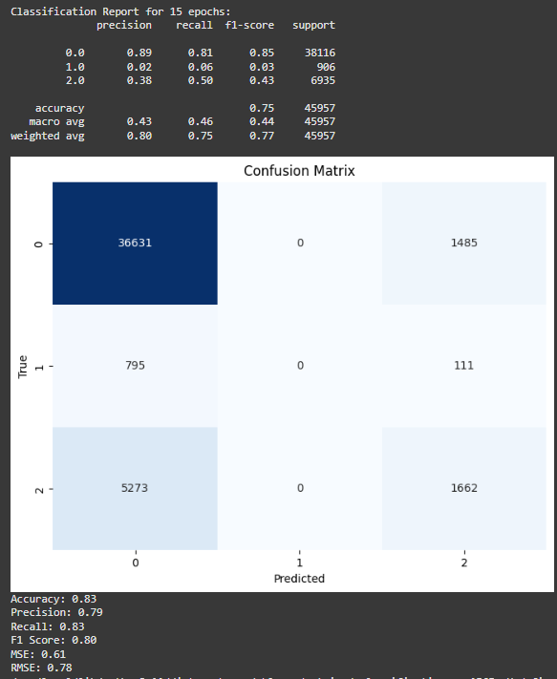
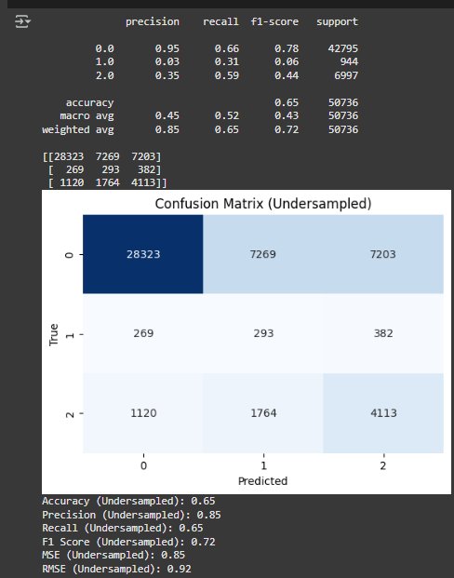
Smote Sampling for neural network
Using Undersampling for Logistic regression

Slide 16
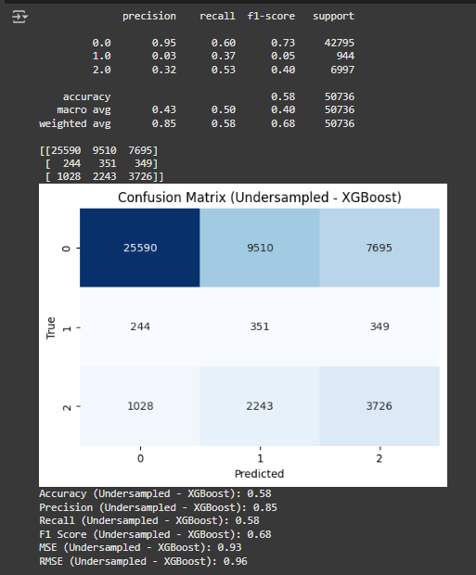
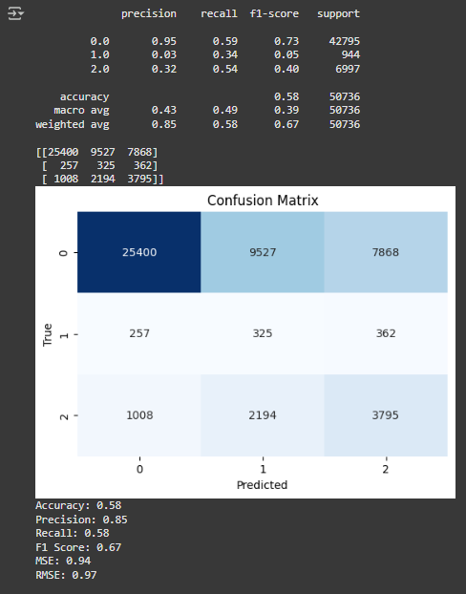
Undersampling for XG boosting
Using Understanding for Random Forest

Slide 17
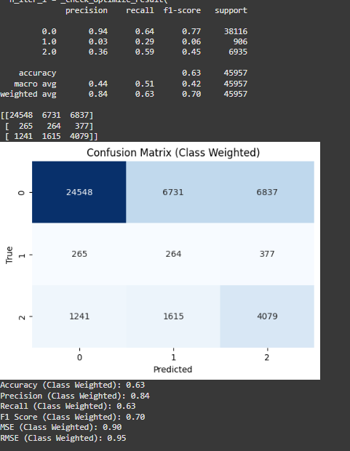
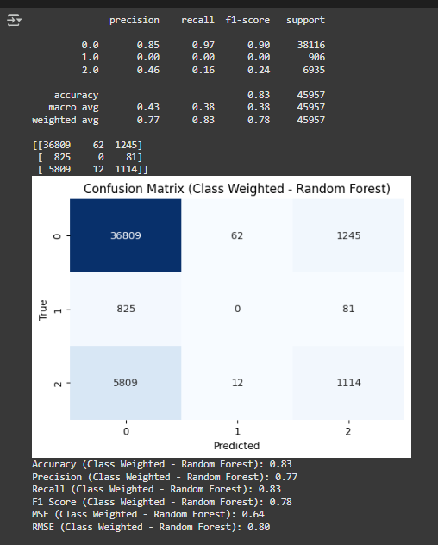
Using Class Weighing Sampling for Logistic regression
Class Weighing for Randomforest

Slide 18
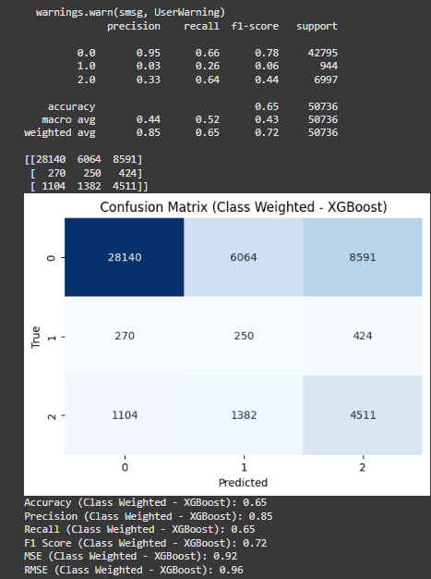
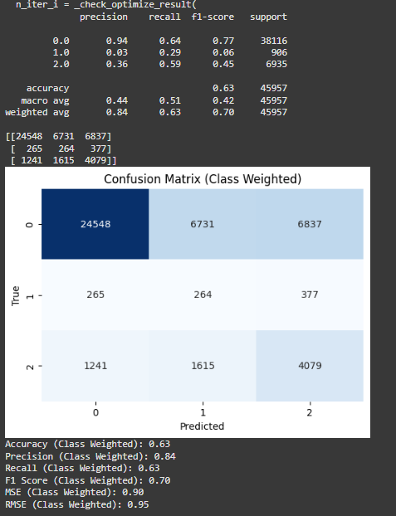
Class Weighing for XG boosting.
Class Weighing for Neural Network

Slide 19
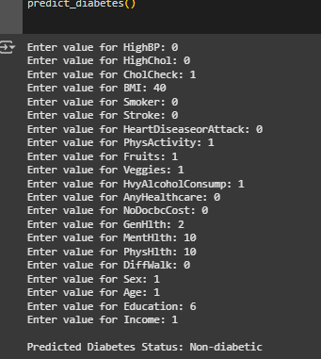
Comparison between models
The random forest model with class weighting sampling outperformed other models in evaluation metrics.
This model can be effectively used to predict diabetes.
This is the result generated when a random user inputs the values.

Slide 20
Future scope
Model Development and Optimization
Implement K-fold cross-validation to enhance model robustness and performance.
Explore alternative sampling techniques to improve data representation and classification accuracy.
Investigate various hyperparameter tuning methods to optimize model performance and achieve superior results.
Web Application Development
Develop a user-friendly website with an intuitive interface to deliver seamless prediction capabilities.
Ensure the website provides accurate and efficient output predictions for end users.

Slide 21
Conclusion
Our analysis of the Diabetes Health Indicators Dataset shows that both physical and social factors influence diabetes risk. High BMI and lack of physical activity are linked to greater risk, while higher income and education levels appear protective. Clustering revealed distinct risk groups, offering potential for targeted interventions. However, the data is self-reported and cross-sectional, which limits deeper conclusions. Future work should include dietary, genetic, and long-term data. These findings support a well-rounded approach to diabetes prevention that considers personal habits and social conditions.

Slide 22
Q & A

Slide 23
Thanks!

Slide 24
Reference
Teboul, A. (2022). Diabetes Health Indicators Dataset [Data set]. Kaggle.
https://www.kaggle.com/datasets/alexteboul/diabetes-health-indicators-dataset
American Diabetes Association. (2023). Standards of Medical Care in Diabetes—2023.
Diabetes Care, 46(Supplement 1), S1-S272.
World Health Organization. (2021). Global report on diabetes. World Health
Organization.

